Slide 1


Problem-5: Implementation of Chained hash tables
Submitted To-
Dr. Maheen Islam
Associate Professor
Department of Computer Science and Engineering

Slide 2
Submitted By
Name | ID
Ajazul Haque Akaeid | 2018-3-60-119
Md. Ashiqur Rahman Dipu | 2019-3-60-065

Slide 3


Introduction of Chained hash tables
Chained hash is a useful searching process in data structure.
Searching of time complexity depends on order of n; “n” is the number of element or key.
In a hashing the time complexity depends on order of constant. It’s order of 1.

Slide 4

Chained hash process
Hashing process is conduct with two system in data structure.
They are “Hash function” and “hash table”.

Slide 5
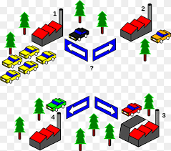
Hash function
Division method-> k%m.
Mid square method-> K^2.
Folding method-> 34 55 45.

Slide 6
Division method in Hash function
Division method is a method where the key is mod with hash table size;
K=key and m=hash table size
Suppose k=5 and m=10
so, k%m = 5%10
= 5 (This is the address of key)
So, k=5 & address of k is 5 no index.

Slide 7
Mid square method in Hash function
Mid square method is a method where the key is squared
Suppose, here k^2 = 3786^2
= 14 3337 96
So, the address will be taken is “3337”.

Slide 8
Folding method in Hash function
Folding method is a method where; key will be split that’s mean it will divided.
Suppose, “1347” -> 13 47
-> 13 + 47 (add after split)
-> 60

Slide 9
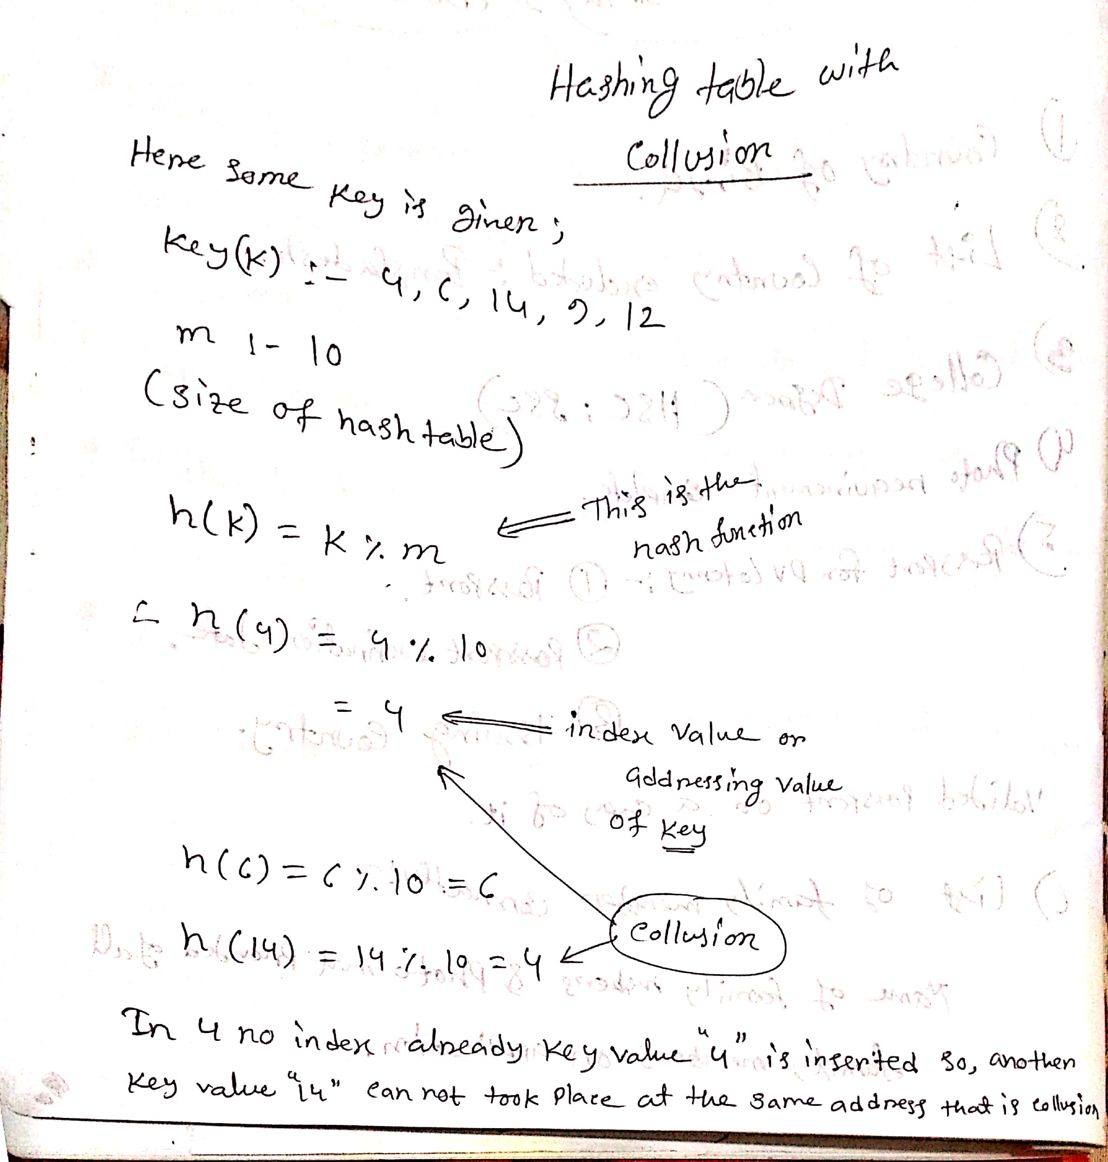
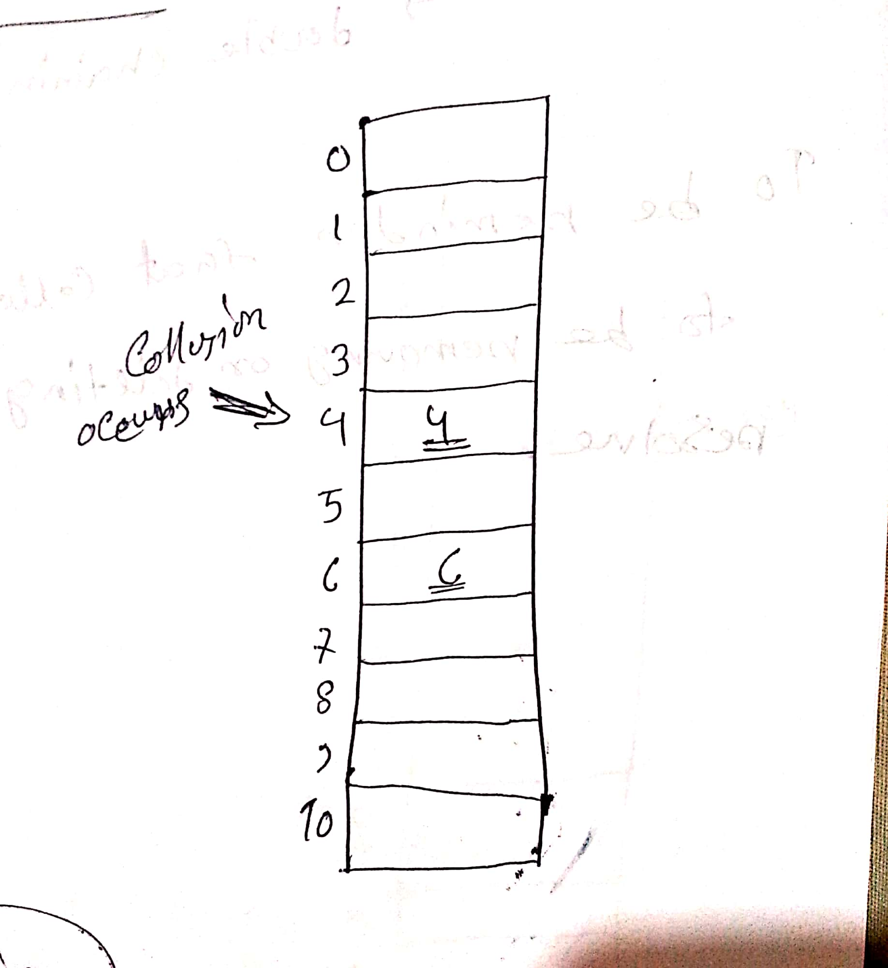
Hash table with collision

Slide 10
Hash function resolve hash table with collision
So, when there’s collusion occurs and to resolve the collusion there’s a certain way;
Open hashing (closed addressing)
->chaining (chained hashing).
Close hashing (open addressing)
->double chaining (double chained hash)
To be reminder that collusion is not meant to be removing or deleting, it’s mean to be resolve.

Slide 11
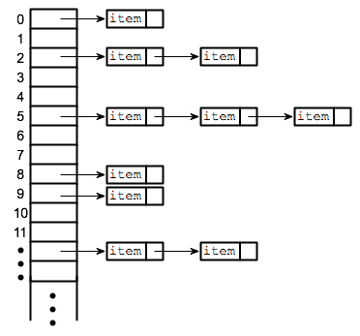
Chained hash table
So we see when addressing the key there’s collusion occurs. We are gonna resolve the collusion by implementing chained hash table.
This project is conduct over chained hash table to resolve collusion in data structure.

Slide 12
Chained hash table
In collusion we used chain hash table to resolve it. In a chained hash there a linked list added and put that next key on that collusion address.
We see when we insert the key element there’s collusion occurs. In chaining (chained hash table) it’s a closed addressing, and we add linked list which is single linked list to resolve the collusion pattern.

Slide 13
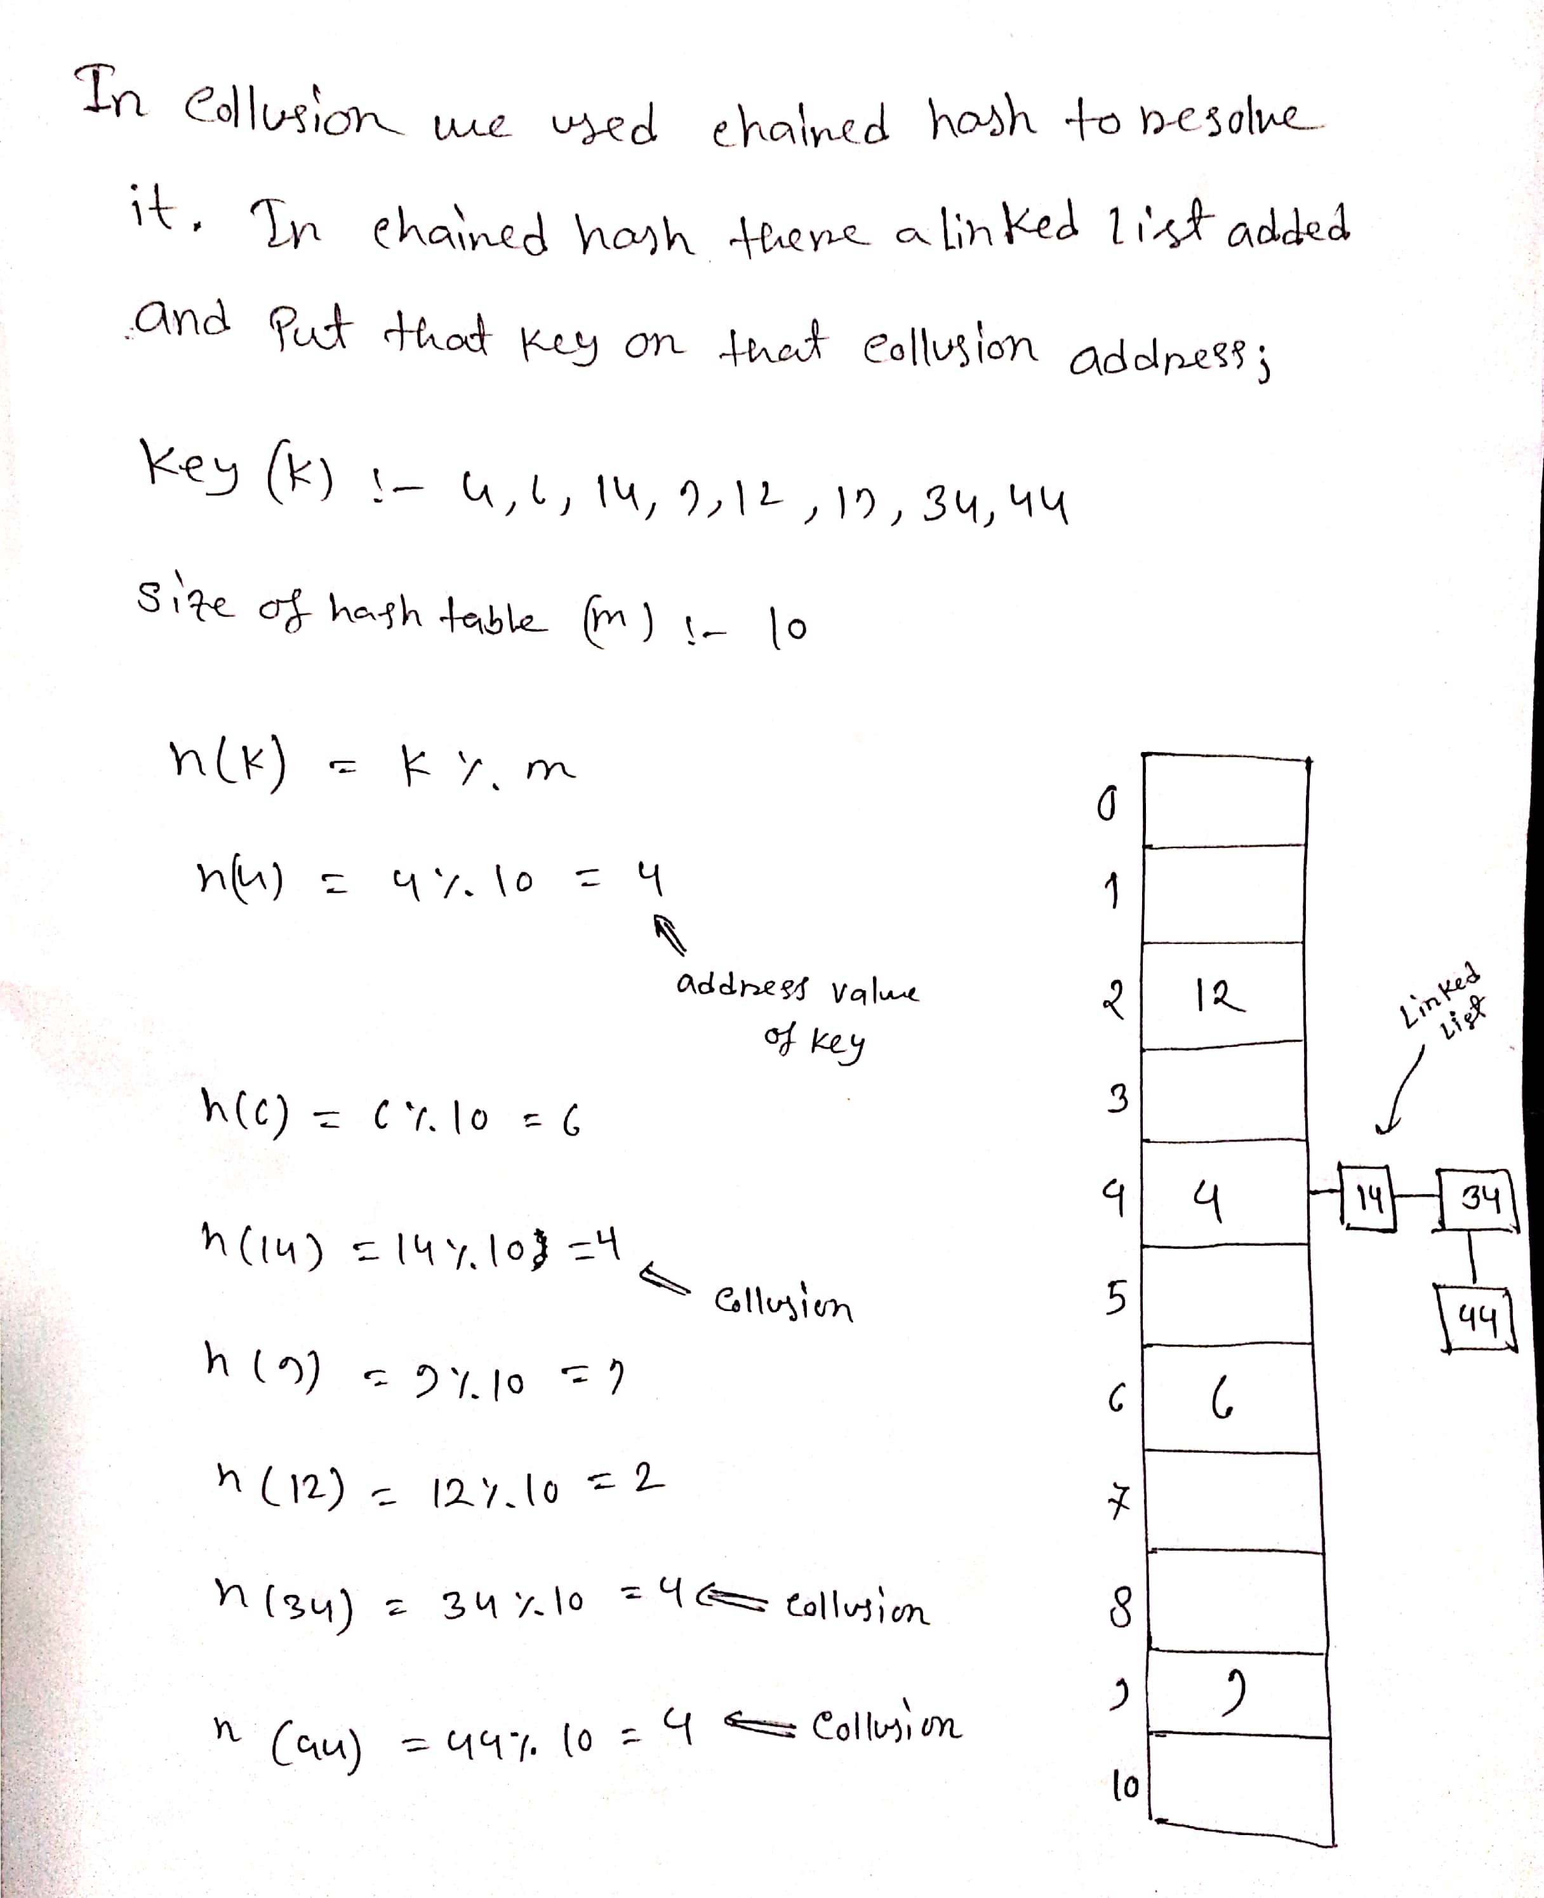
Chained hash table

Slide 14
Chained hash table
When we mod 4 & 6 the address is located to the index 4 and 6. But in 14 the address is located to index 4. In same location key value 4 & 14 can not placed. Already one key value is inserted. So, in chained table to resolve this collusion linked list is needed and inside the linked list the next key element will be placed. So in h(34) it took place in 4 no index and replace in the linked list. Again h(44) it took place in 4 no index and replace in the linked list.
So this is the process which is applied to avoid the collusion by chained hash table in data structure.

Slide 15


